Slide 1
Object Orientated Programming
(not the same as
Procedural Programming)
Have the students follow along on canopy

Slide 2
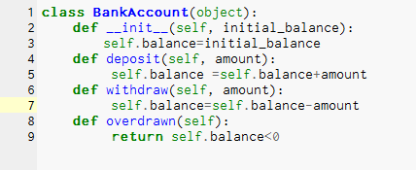

Slide 7
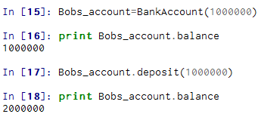
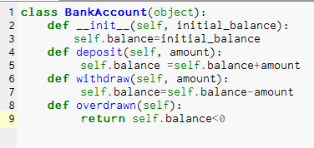

Slide 12


Slide 14


Slide 16
7 minute recap video
https://www.youtube.com/watch?v=M1BAlDufqao

